Slide 1

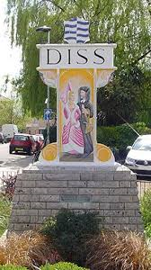
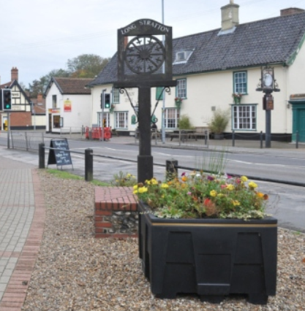
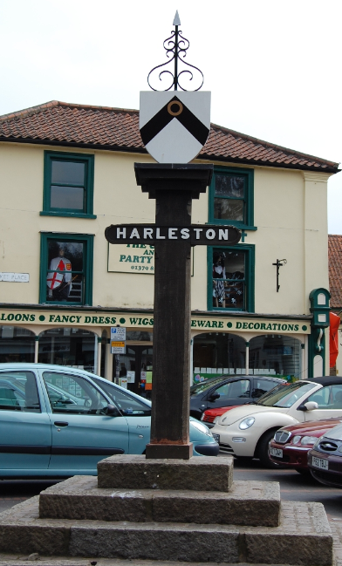
South Norfolk District
Harleston Public Meeting
Tuesday 9th April 2024

Slide 2
Agenda
Introduction – Microsoft Teams as a platform
The Team
Crime figures
Current priorities & feedback
Priority setting discussion
Plans going forwards
Questions

Slide 3
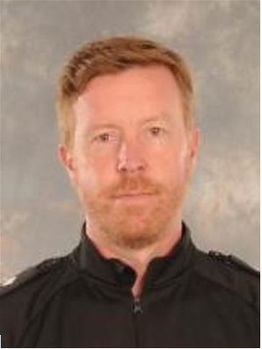
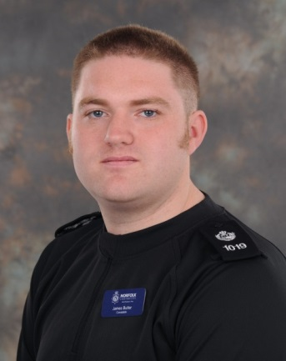
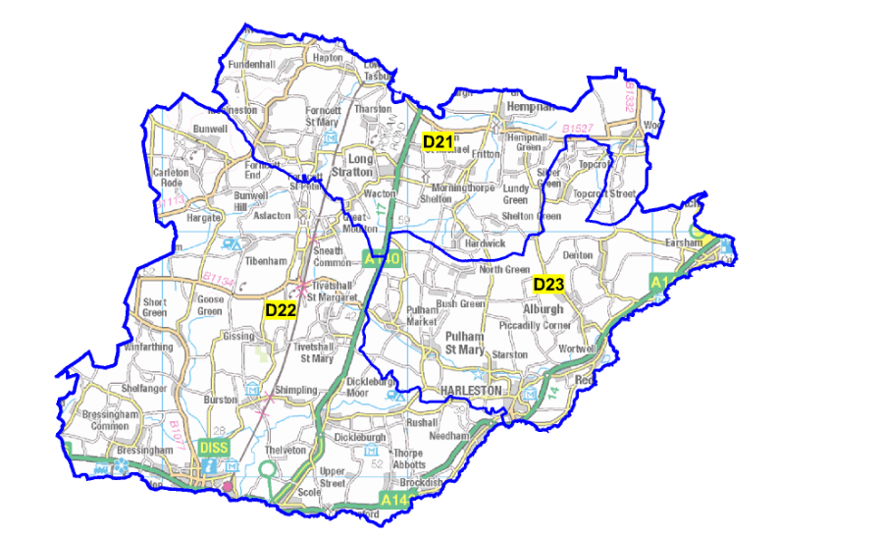
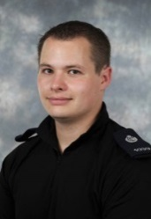
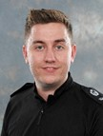
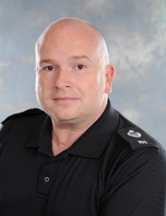
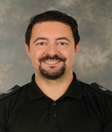
Meet the Team
Inspector Terry
Safer Neighbourhood:
Sgt Butler
Harleston Beat Manager:
PC Steve Phillips
Rural Crime Beat Manager:
PC James KING
Diss Beat Manager: PC Andy Baker
Long Stratton Beat Manager: PC Tom Hall

Slide 4
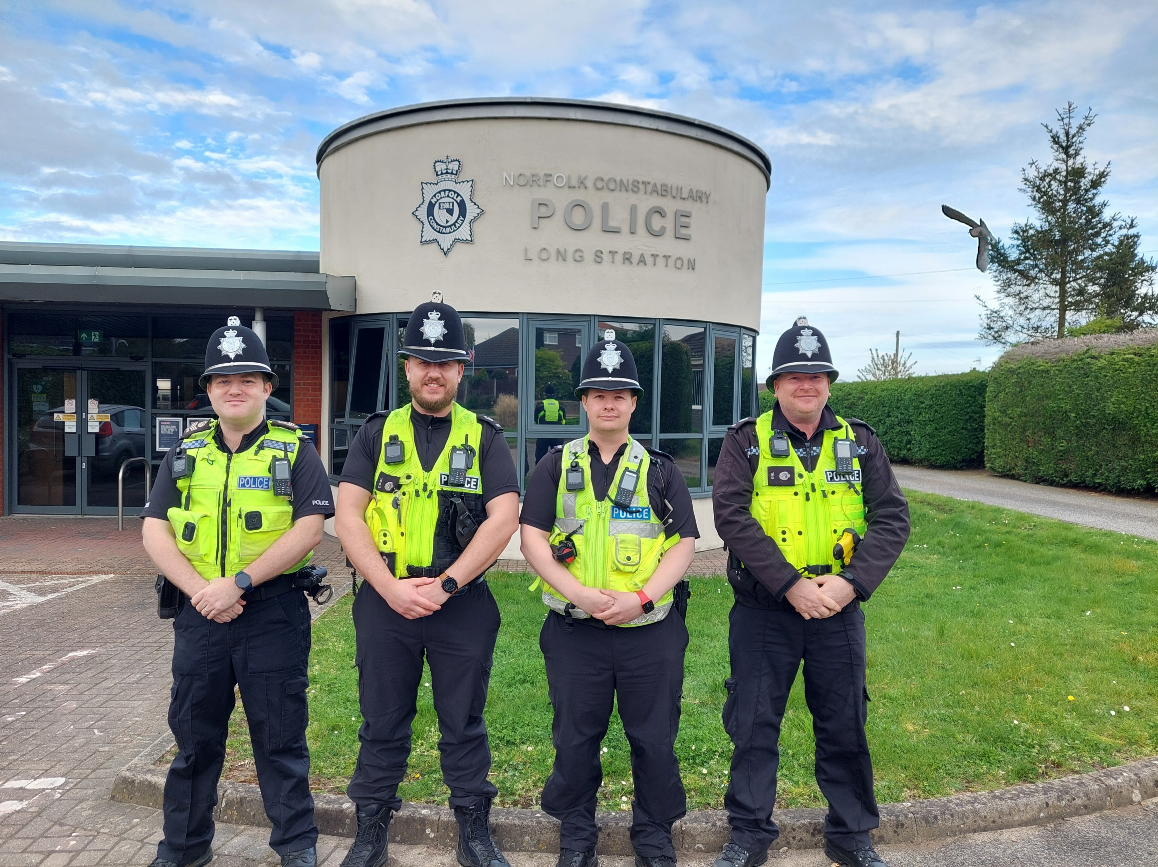
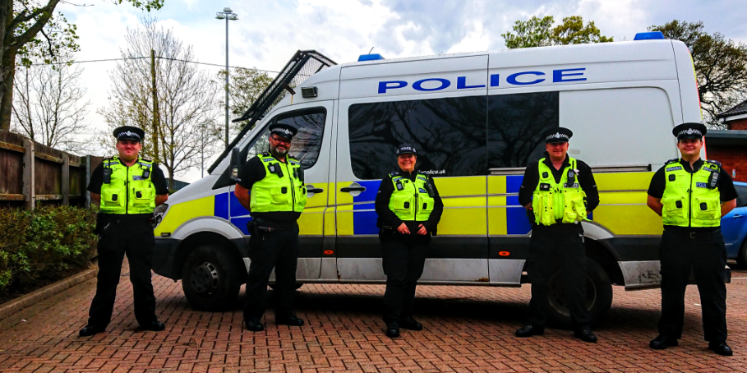
Team
5 x Inspectors
6 x Sergeants
29 x Constables
2 x Special Constables
3 x Dog Handlers
2 x Admin Staff
1 x Volunteers
Police Stations
Diss
Harleston
Long Stratton

Slide 5

Towns and Parishes
Harleston, Alburgh, Denton, Earsham, Pulham Market, Pulham St Mary, Redenhall, Starston, Topcroft, Wortwell, Brockdish, Thorpe Abbotts, Dickleburgh, Rushall, Needham, Billingford and Scole.
Previous Priorities
Road Safety
Nuisance ASB
Drugs
PC Steve Phillips
Harleston Beat Manager

Slide 6
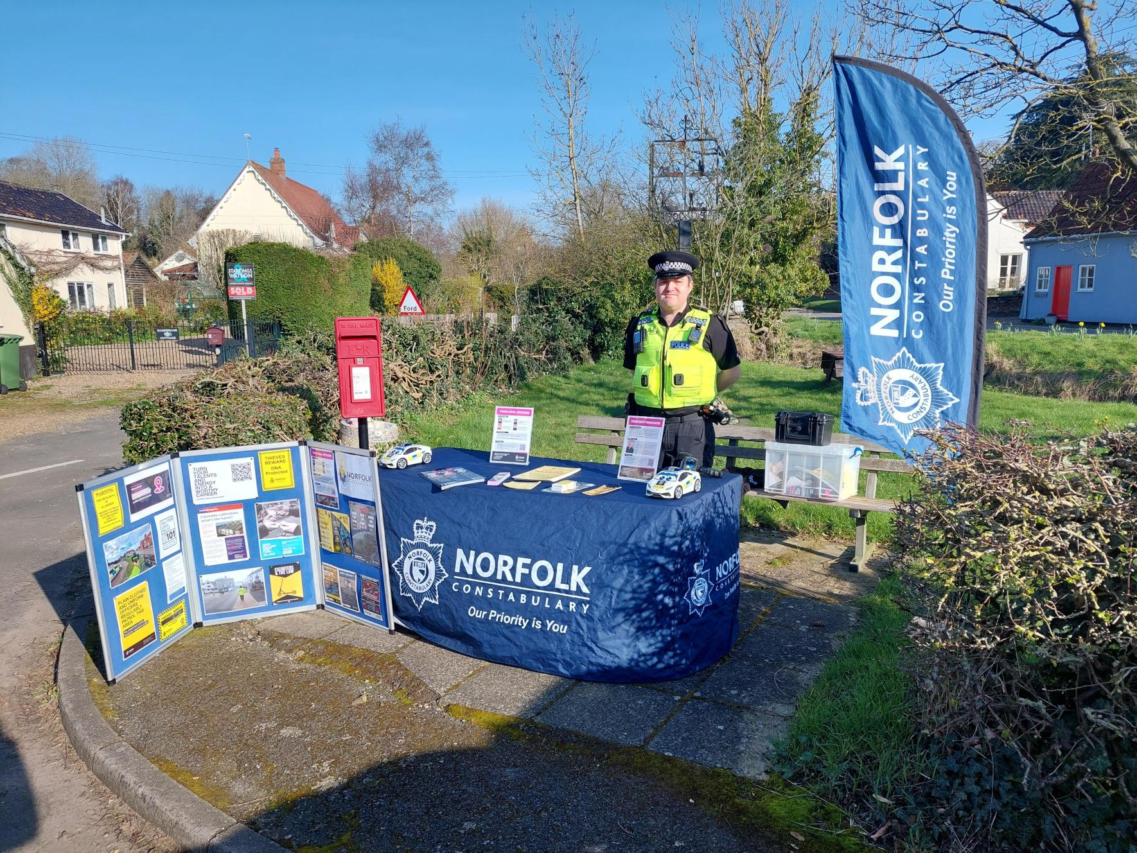
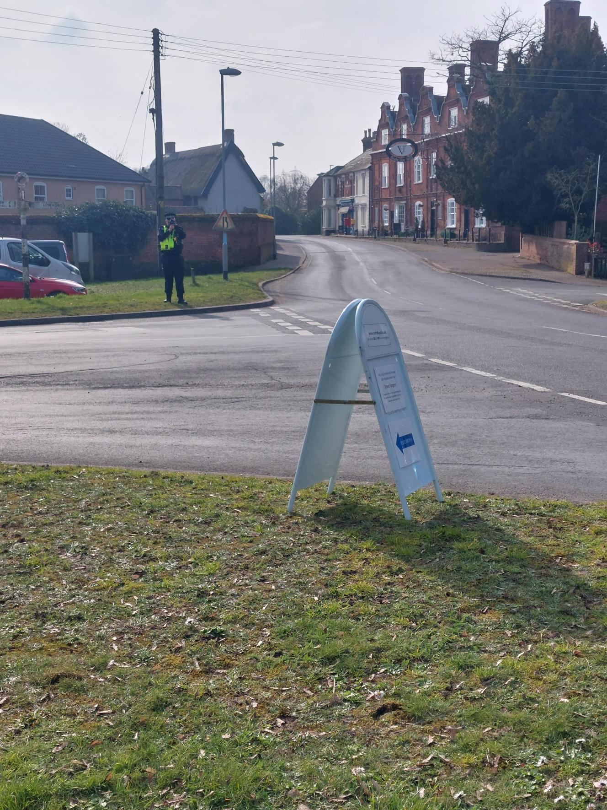
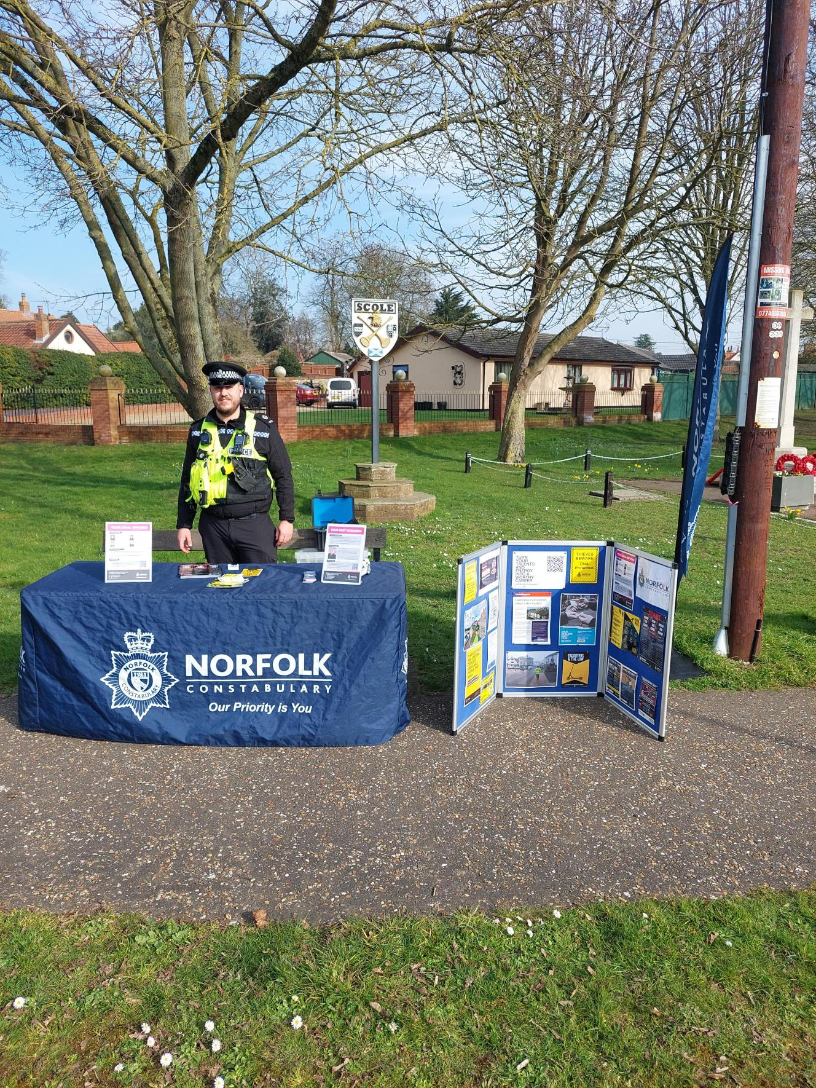
Recent Engagements
Over 120 High visibility patrols & public engagements conducted in last 90 days
Speed enforcement
Covert Speed Monitoring Surveys
Public Street Surgeries in Harleston, Scole and Brockdish
High Visibility foot patrols targeting ASB
Offenders charged with – ASB & Criminal Damage
Youth Club Engagement talks around personal, online and road safety
Supporting public events across the district
Proactive cycle patrols
Working with local schools to tackle road safety. .
Partnership work with councils in regards to resolutions for neighbour disputes.
Supported response officers with volume crime investigations and protecting vulnerable people.

Slide 7
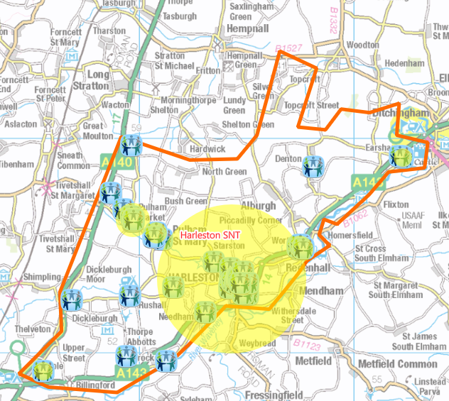
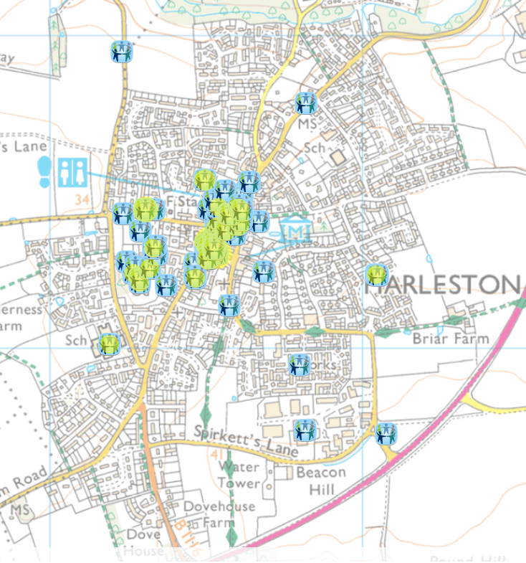
Engagement Map
Engagement Event
More than one Engagement Event

Slide 8
You say. We do.
Road Safety
Speed enforcement carried out at a variety of locations around the area with a number of Traffic Offence reports issued
1 driver has been issued a traffic offence report for using a mobile whilst driving
New PSPO has been put in place to assist with Road related ASB
Nuisance ASB
ASB reports have significantly dropped over the last 3 months.
Increased Patrols around the Pulham’s due to reports of concerning behaviour.
A youth has been charged with Criminal damage to the Tommy Silhouette in Harleston.
Drugs
There have been a couple of drugs warrants conducted around the area which have lead to suspects being arrested.

Slide 9
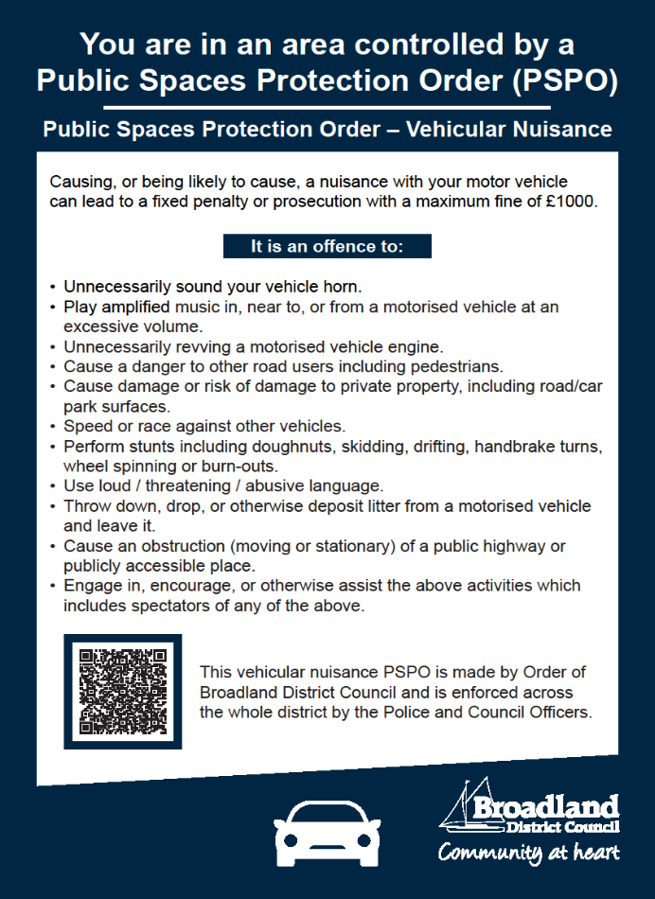
Public Space Protection Order

Slide 10
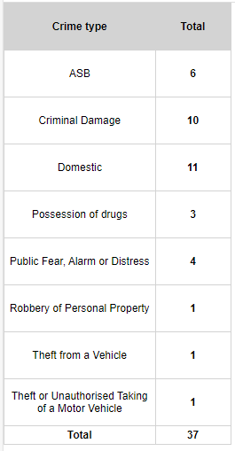
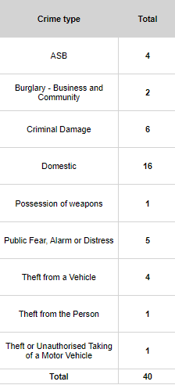
Reported Crime for the last three months
Harleston, Earsham & Beck Vale Wards, Dickleburgh & Scole Wards
Jan 24 – March 24
Oct 23 – Dec 23

Slide 11
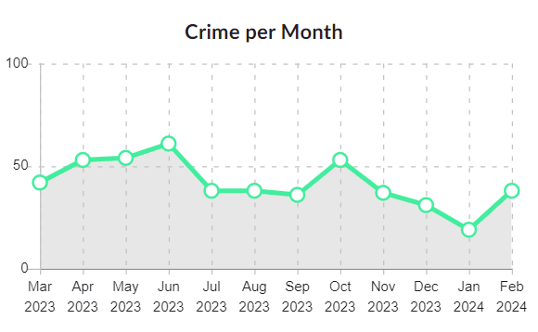

Slide 12
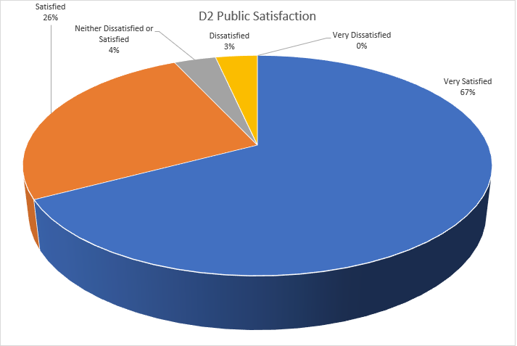

Slide 13
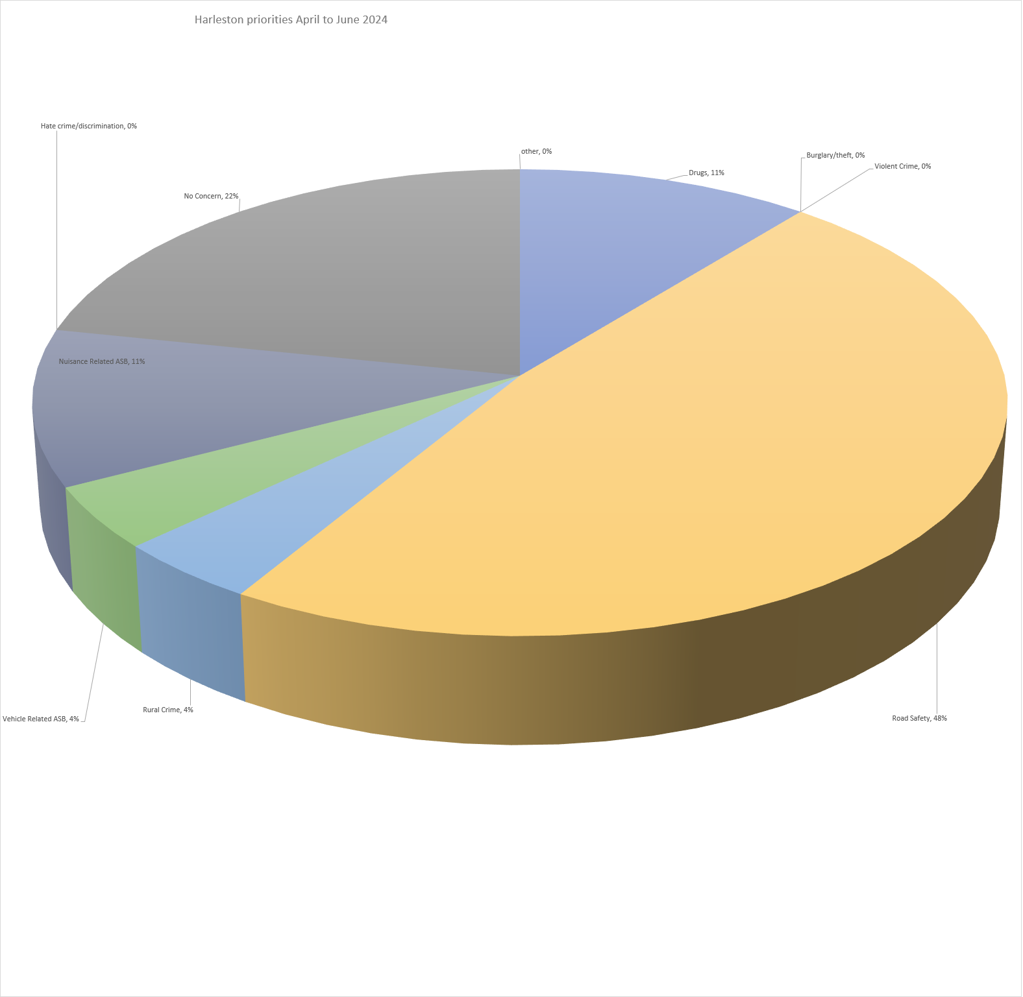
Priorities for the next three months.
Road Safety 48%
(inc. Speeding)
Nuisance ASB -11%
Drugs – 11%
22% of people said they
Have no concerns

Slide 14
Any Questions?

Slide 15
Thank you www.norfolk.police.uk
If you have any queries please email us at:
SNTHarleston@Norfolk.police.uk

