Slide 1
Diss, Long Stratton & Harleston Quarterly Neighbourhood Policing Meeting
^{19th} OCTOBER 2025

Slide 2
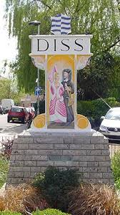
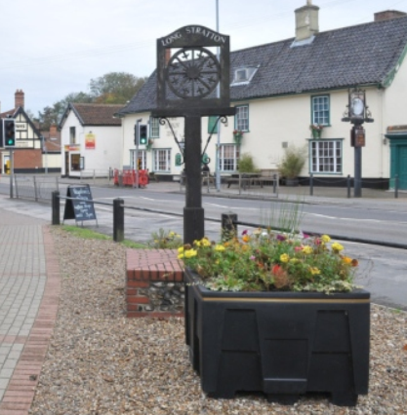
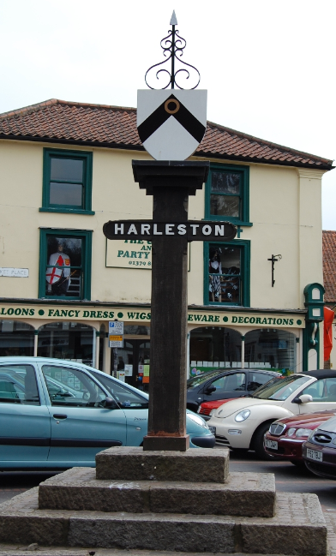
Welcome
&
House keeping
Notes:
Fire exits, sign in sheet if you haven’t done so already, we do have a question and answer session at the end but please do ask questions as we go along, please put you hand up if you have any thing to ask. If you are hear with us online, you can use the chat function which we will try and monitor or put your virtual hand up. We haven’t done a hyrid meeting before and we haven’t done a face to face for some time so it’s a bit of a learning curve, we are trying some new things so please be patient with us.

Slide 3
Agenda
Introduction to the area.
Role of your local officer
Your local area (including crime trends and recent work)
Community priorities
Public satisfaction
Neighbourhood Watch
Crime Stoppers
Useful websites
Questions & Answers

Slide 4
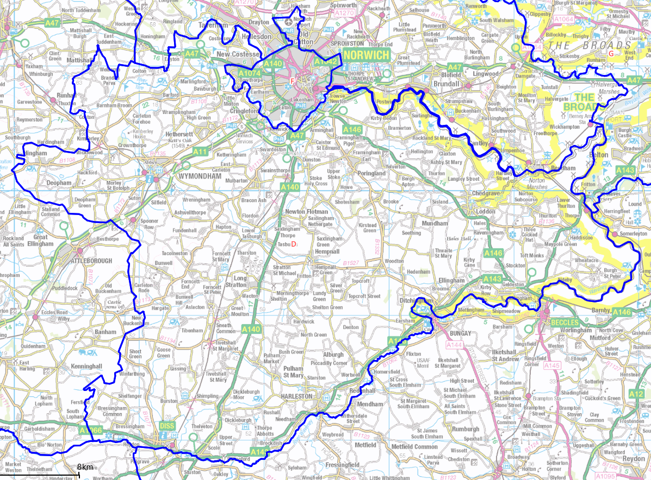
South Norfolk District

Slide 5
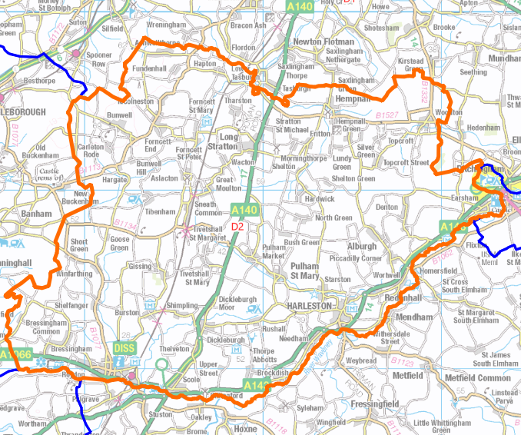
Diss,
long Stratton & Harleston
Safer Neighbourhood team

Slide 6
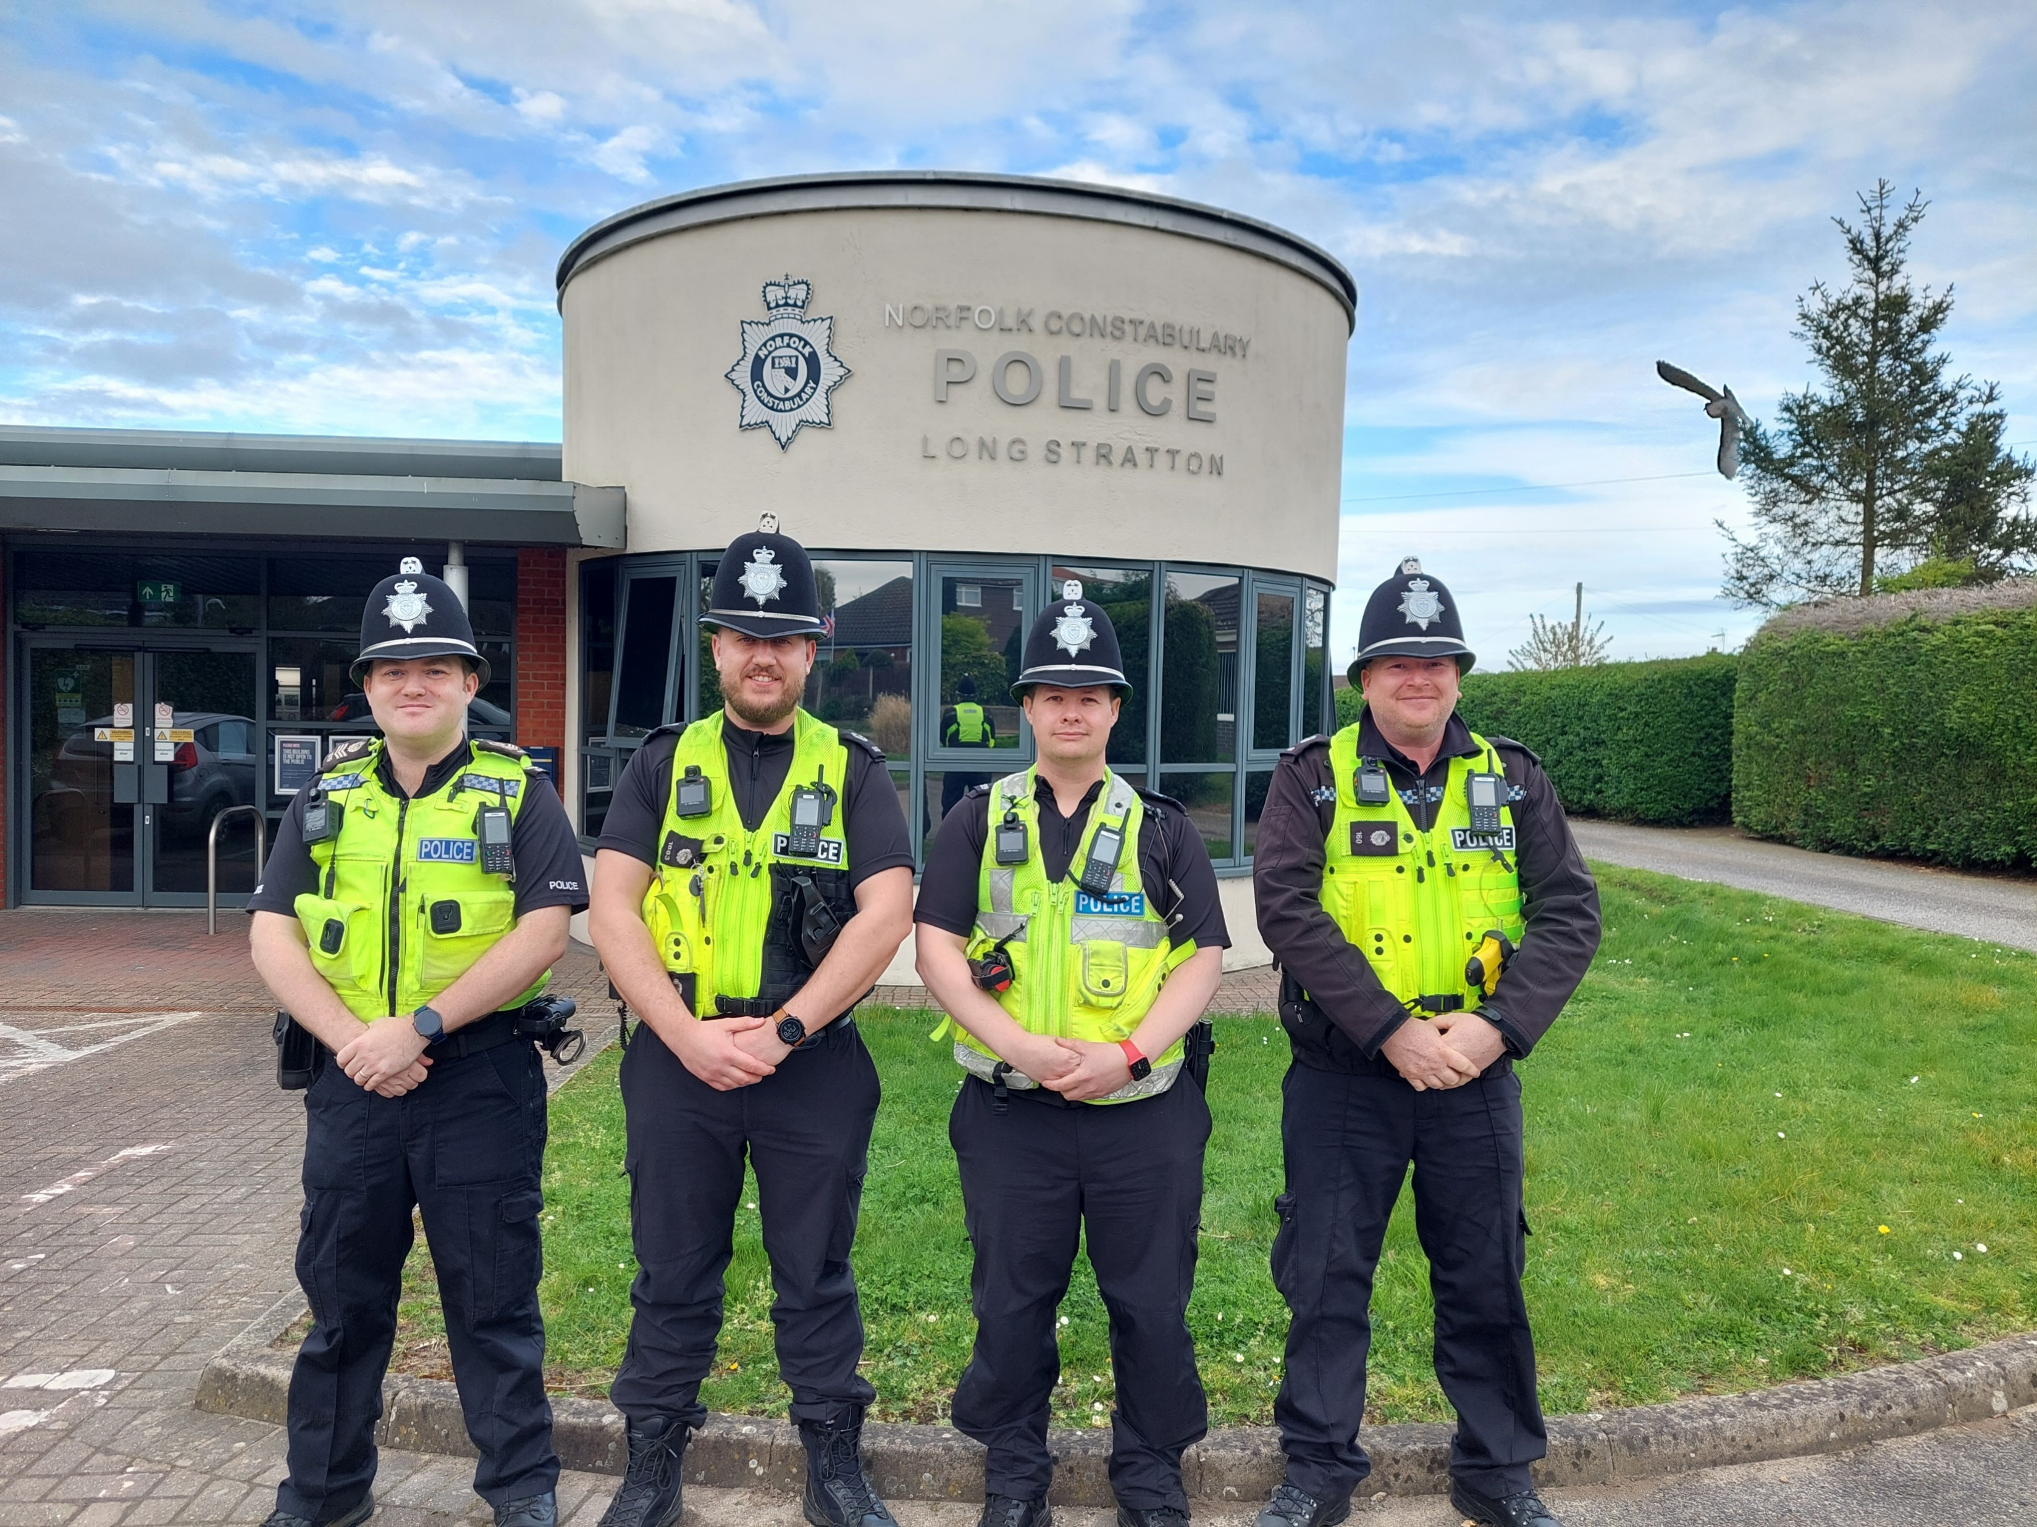
Team
6 x Area Inspectors
6 x Sergeants
20 x Constables
3 x Dog Handlers
2 x Admin Staff
Police Stations
Diss
Harleston
Long Stratton
Notes:
6 area inspectors cover the whole of the South Norfolk and Broadland and three dogs can cover the whole of Norfolk and Suffolk so not quite
as good as that sounds.
Police stations are operational, they are used, just not open to the public like an old fashioned police station. There is a yellow phone which can be used 24/7 and goes through to our control room. If anyone is there they will usually speak to you if they are available to do so.

Slide 7
Role of your beat manager
The Beat Manager is a local police officer whose aim is to keep your neighbourhood safe to live, work in and visit.
Your Beat Manager is here to engage with local communities and work to solve issues and priorities within your neighbourhood.
Core Functions:
Engagement, visibility and targeted activity.
Community Concerns and Priorities.
Listening to the community and targeting our activity accordingly.
Priorities are set at a district level and a local level by the beat managers.
Notes:
As above

Slide 8
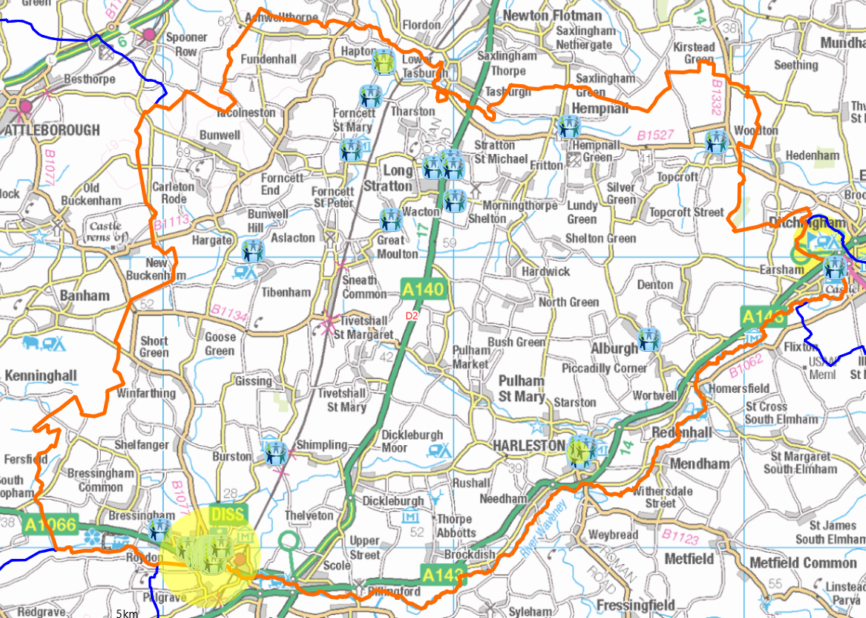
Engagement, visibility and targeted Activity
Over 140 ENGAGEMENTS OVER THE PAST 90 DAYS. – Drop due to summer demand

Slide 9
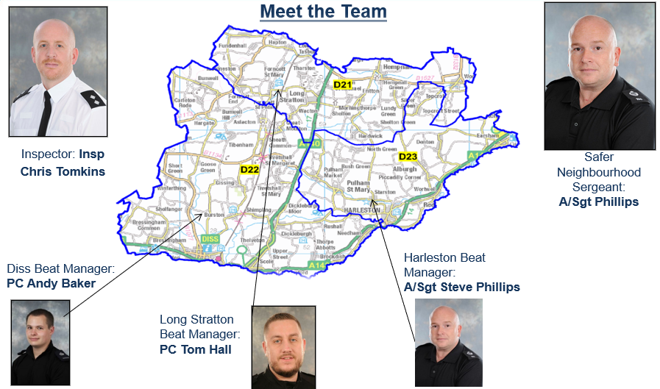

Slide 10
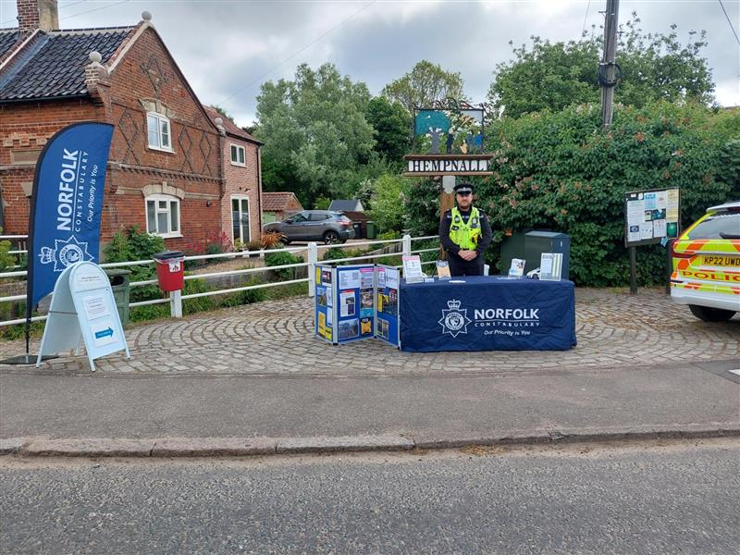
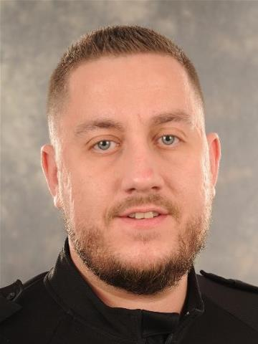
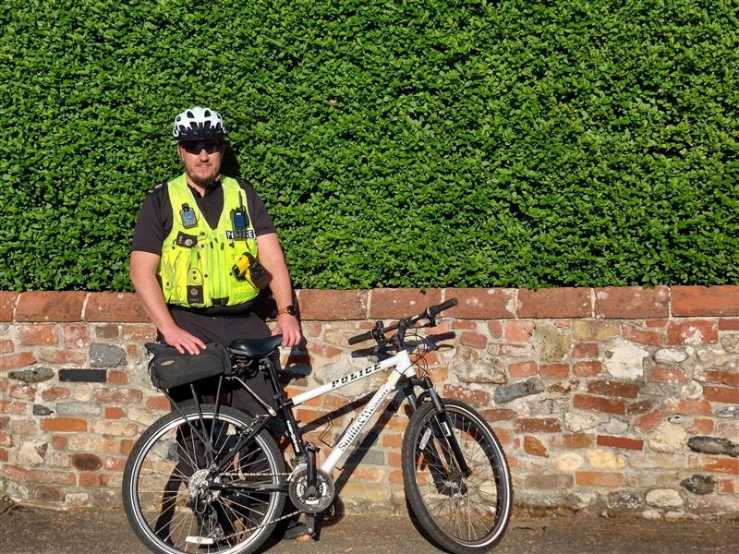
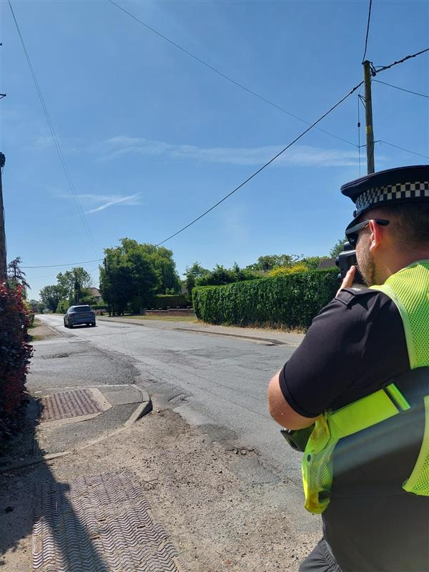
D21 Long Stratton
Pc 1883 Tom Hall
Towns and Parishes
Long Stratton, Ashwellthorpe, Bedingham, Forncett, Fundenhall, Hempnall, Morningthorpe, Fritton, Shelton, Hardwick, Tacolneston, Tharston, Hapton, Wacton, Woodton, Aslacton, Bunwell , Carleton Rode, Gissing, Great Moulton, Tibenham, Tivetshall St Margaret, Tivetshall St Mary and Winfarthing.
Previous District Priority :- Road Safety

Slide 11
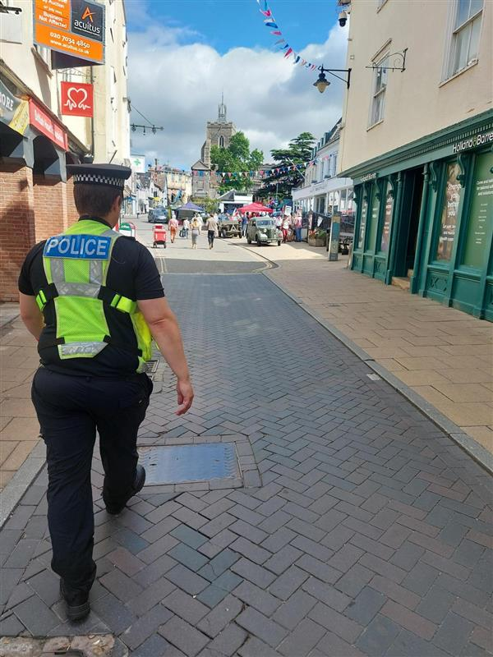
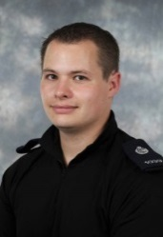
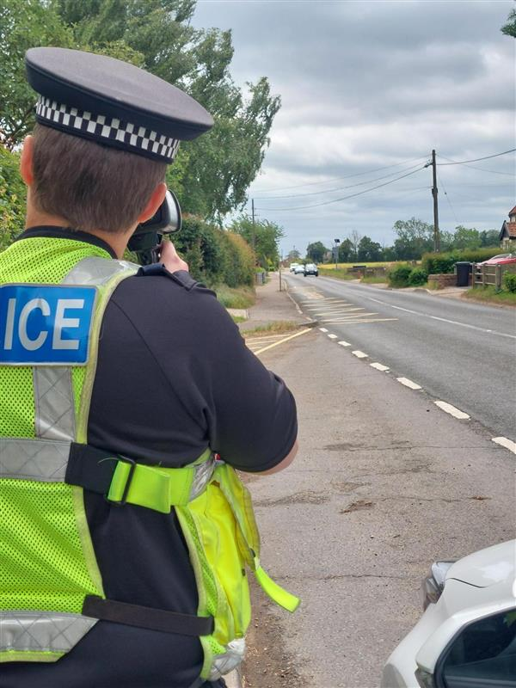
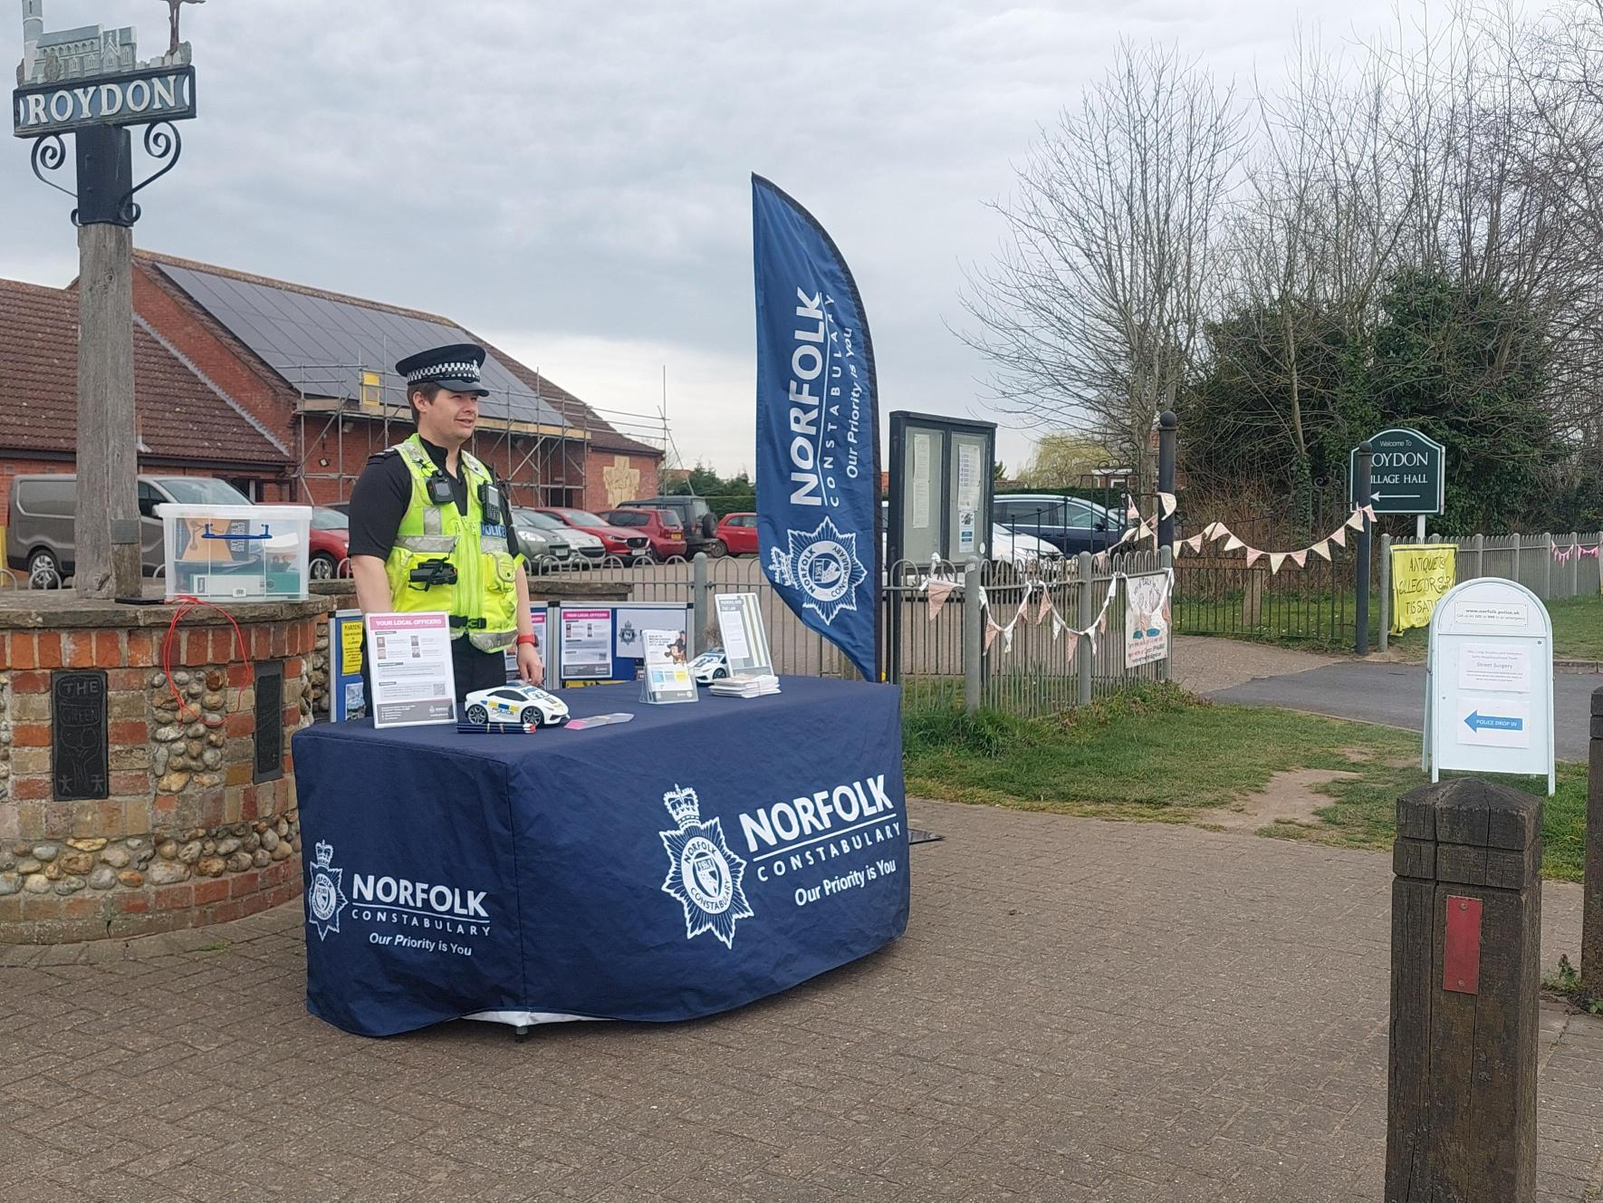
D22 Diss
Pc 1039 Andy BAKER
Towns and Parishes
Diss, Bressingham and Fersfield, Burston and Shimpling, The Heywood, Roydon, Thelveton and Shelfanger
Previous District Priority :- Road Safety

Slide 12
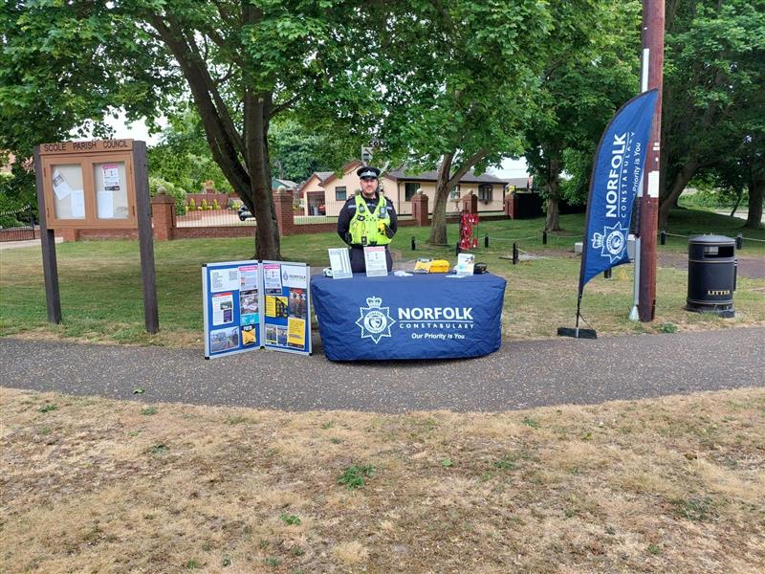
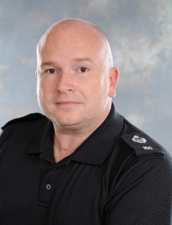
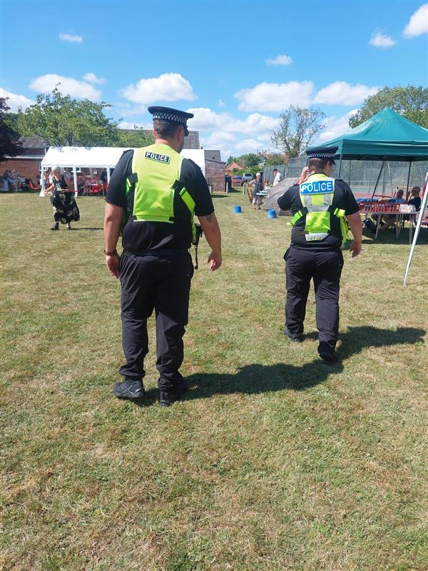
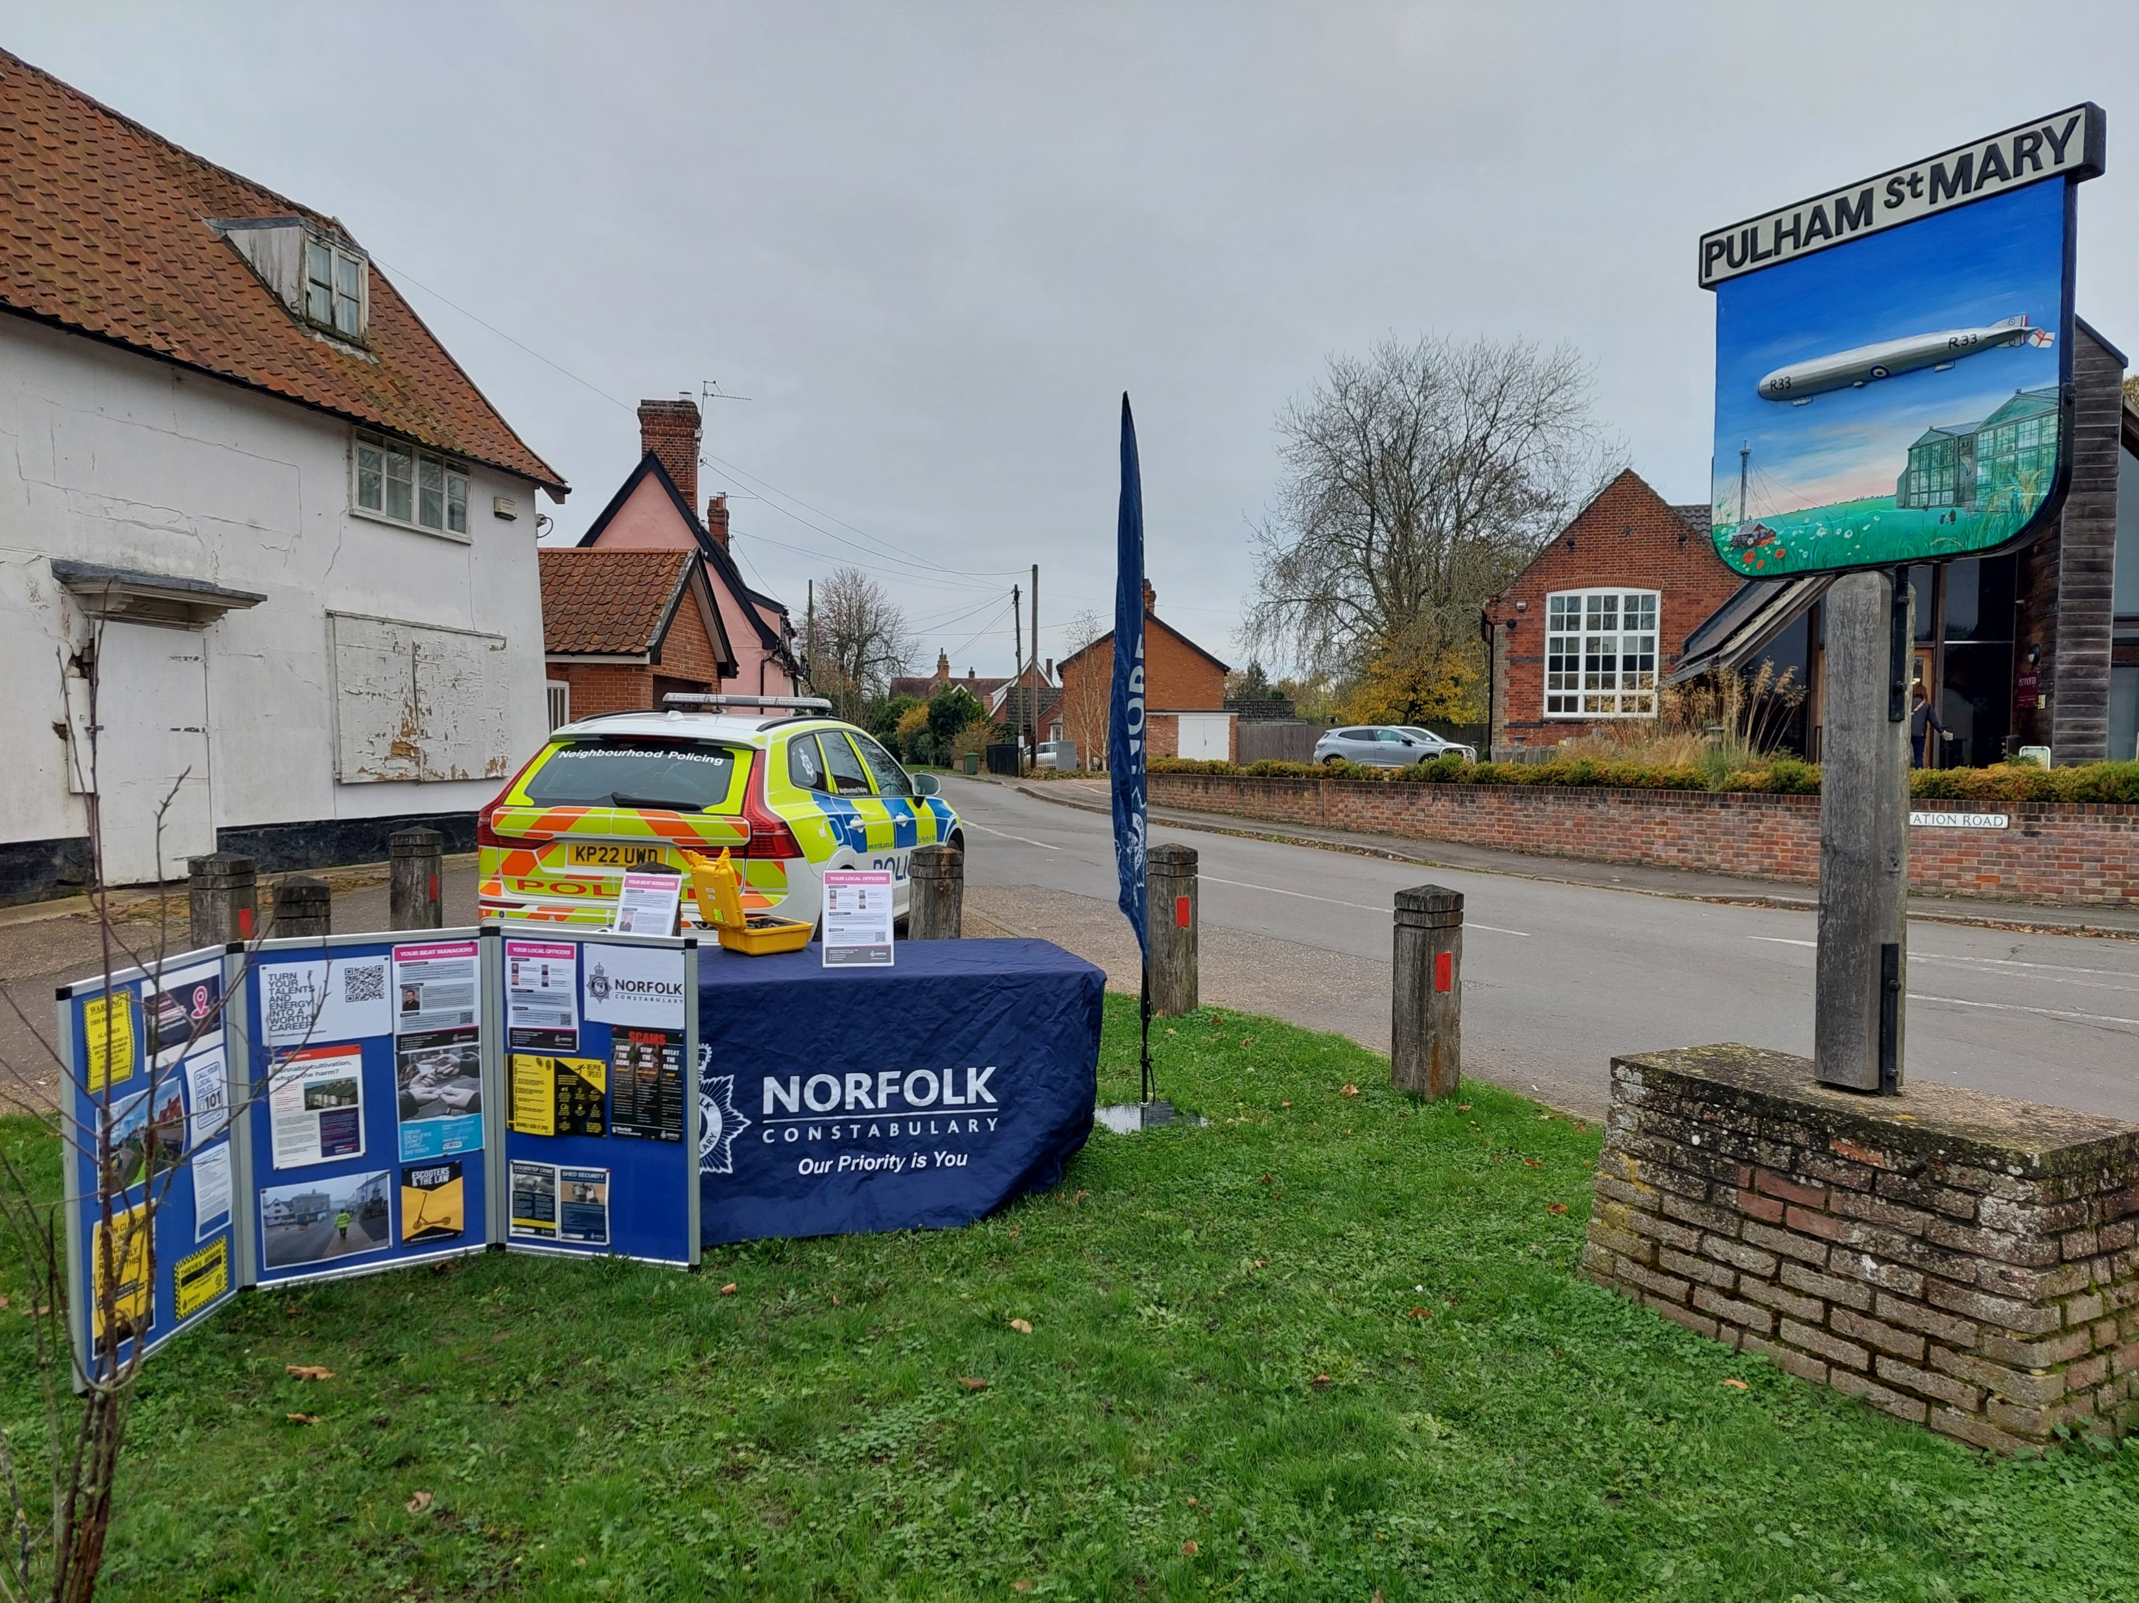
D23 Harleston
A/ps 160 Steve Phillips
Towns and Parishes
Harleston, Alburgh, Denton, Earsham, Pulham Market, Pulham St Mary, Redenhall, Starston, Topcroft, Wortwell, Brockdish, Thorpe Abbotts, Dickleburgh, Rushall, Needham, Billingford and Scole.
Previous District Priority :- Road Safety

Slide 13
What we have been doing
Visited Several Schools and youth clubs –Topics included, internet and online safety, Road safety and keep yourself safe and ASB and the consequences
Received training around the POL-ED teaching platform
Joint Work with our Operational Partnership teams – Multiple CPW’s and CPN’s
Joint visits made with South Norfolk District council and Saffron (Safer Towns)
Joint visits with Trading Standards and Immigration SNDC - 2 Shops had counterfeit or illegal goods removed from the shop
Team Priority enforcement - Speed Enforcement, Section 59’s, Vehicle seizure and Other Traffic Op’s
2 Suspect have remanded 1 For number of serious assaults, 1 for Drug offences
Supported the Eastern Region Special Operations Unit
Warrants
Street Surgeries – Diss, Long Stratton, Harleston, Alburgh, Hapton, Burston, Ashwellthorpe, Dickleburgh.
Library Surgeries
Partner working around neighbour disputes and community resolutions underway
Targeted patrols around schools regarding local concerns/tensions
Delivered Training and upskilled local officers – Carriageway Clearance / ASB powers, policies and legislation / Speed Gun.
Foot Patrols and Cycle Patrols
Abstractions across the summer covering Protests, Lord Mayers, Pride and Response

Slide 14
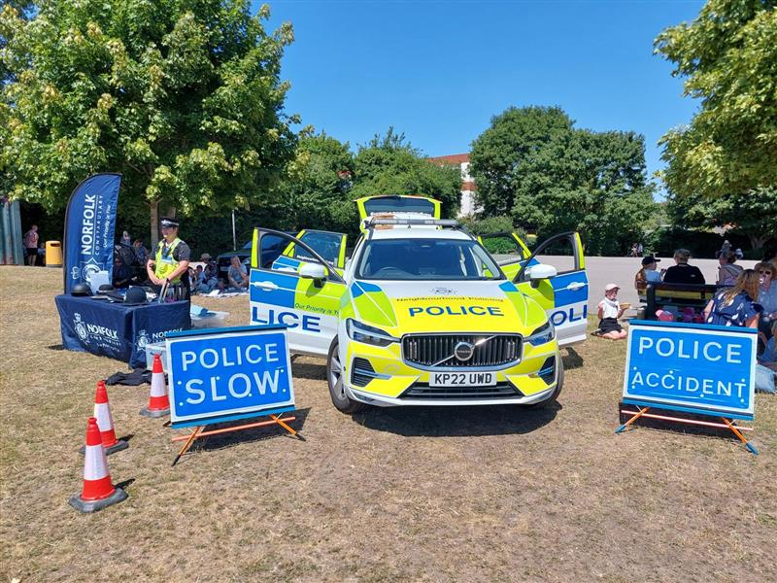
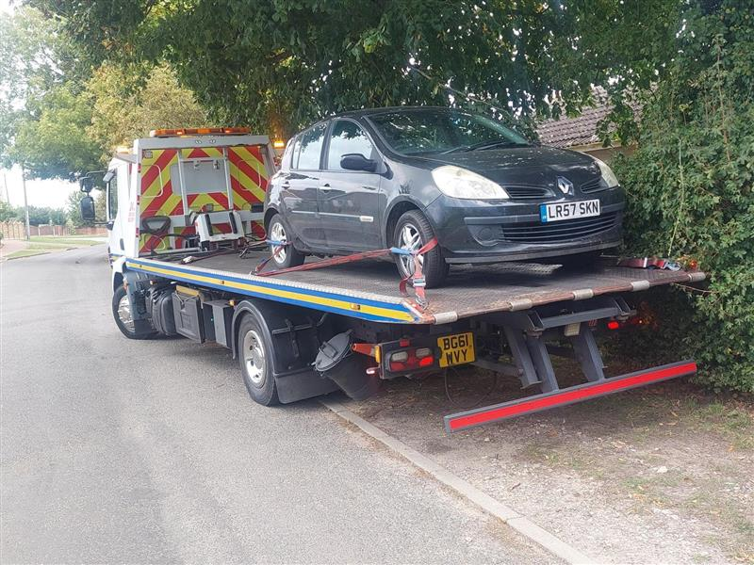
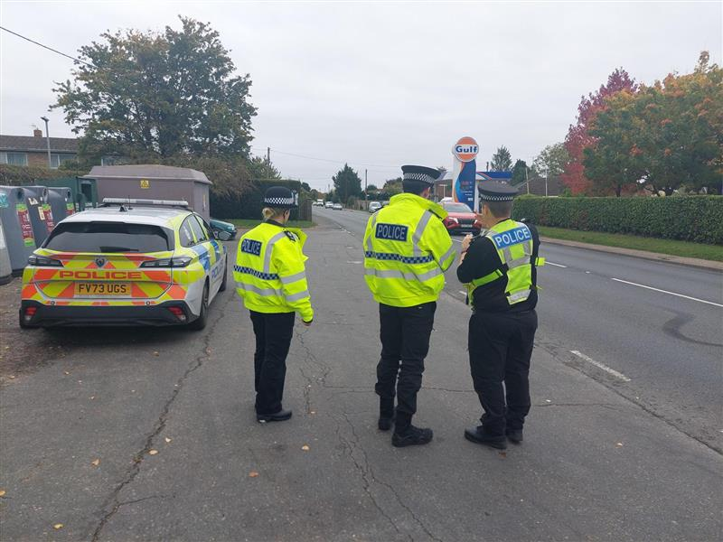
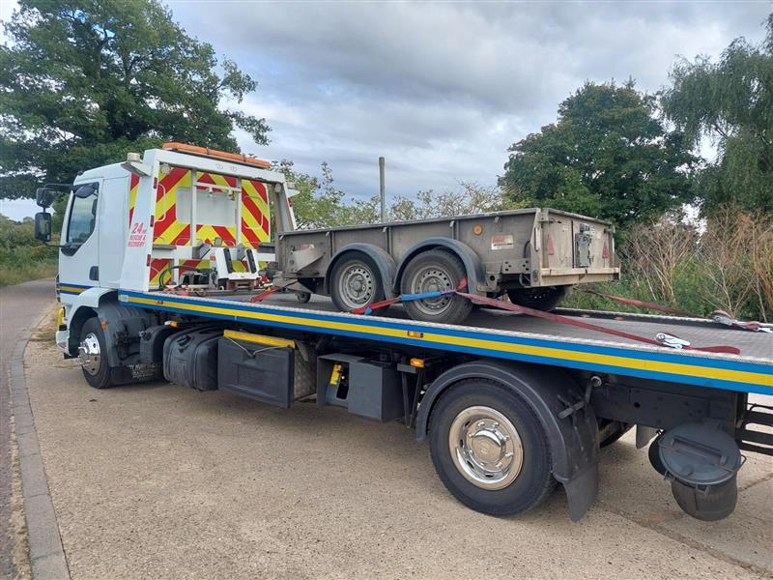
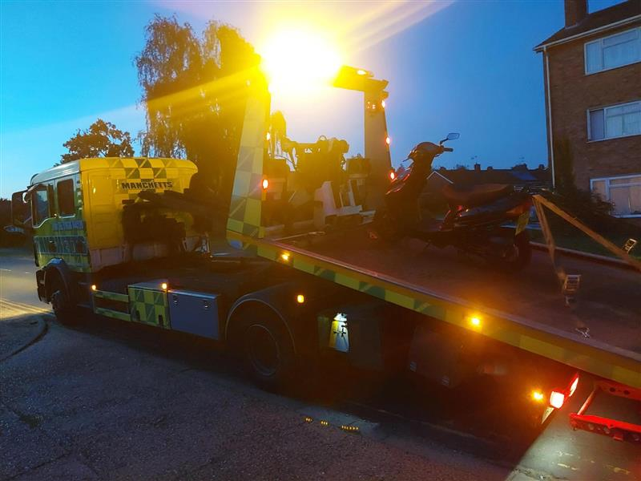
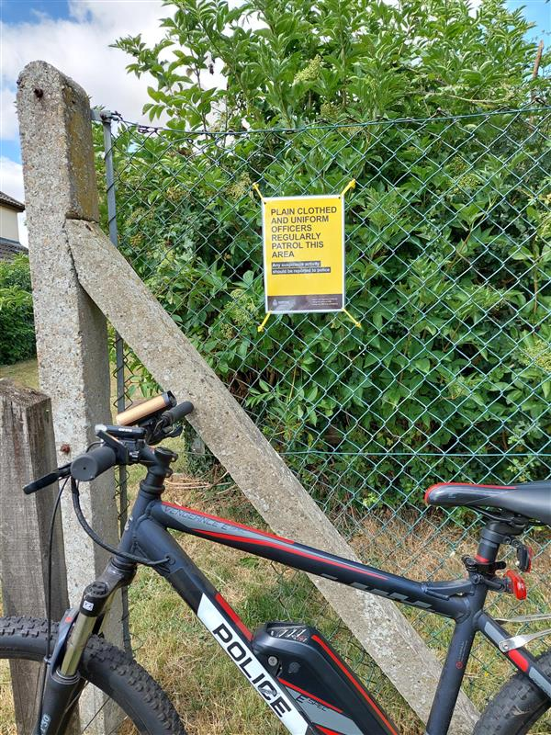

Slide 15
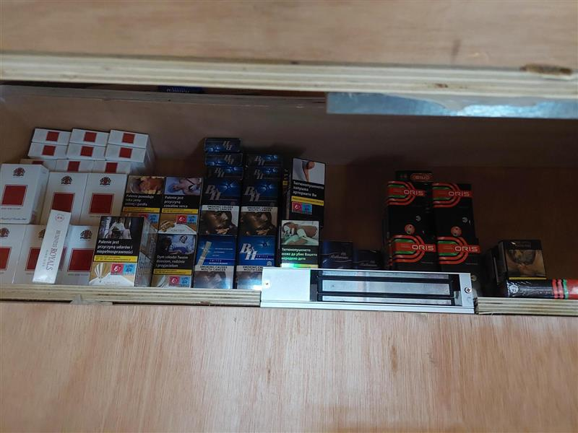
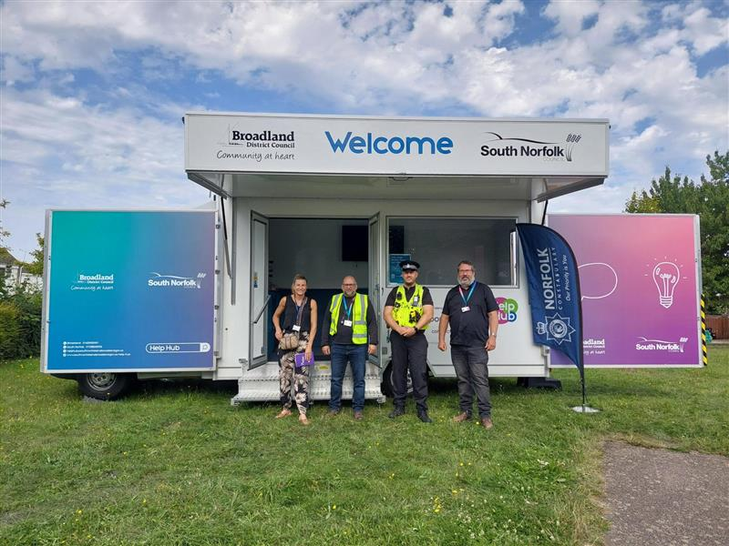
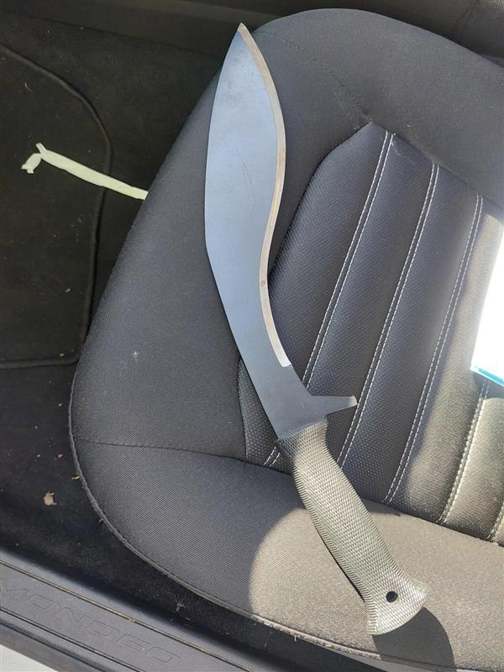
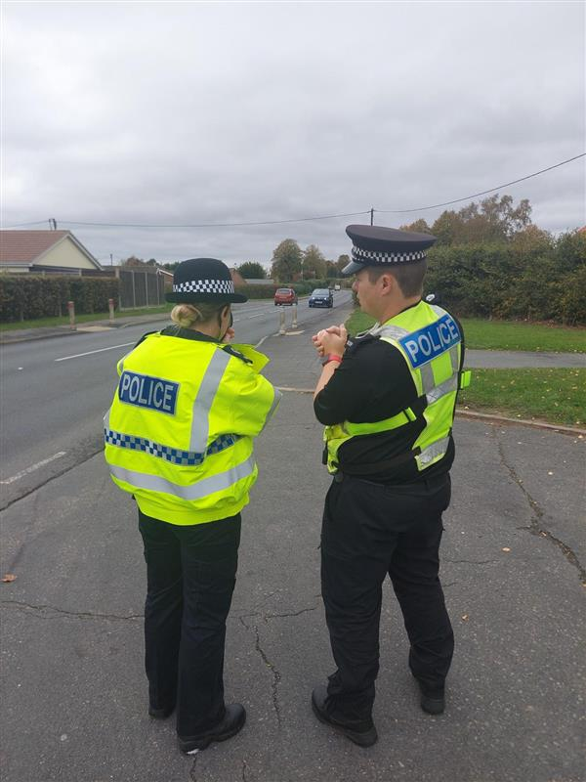
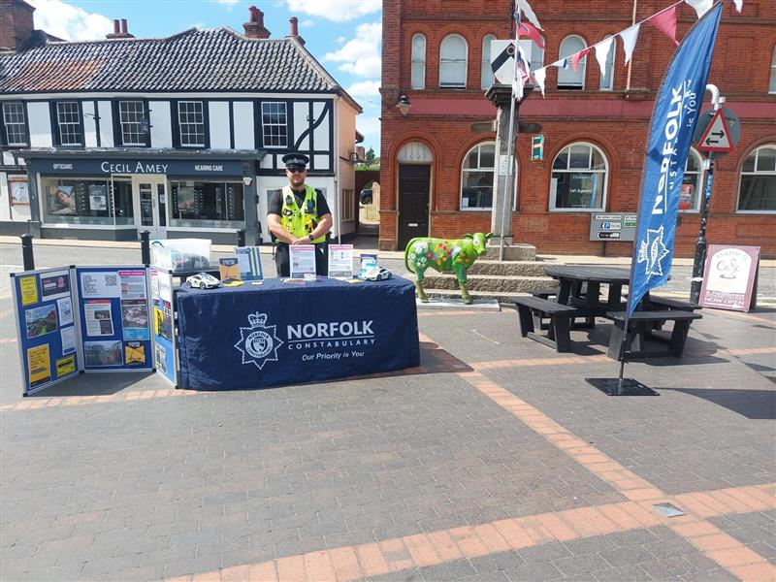
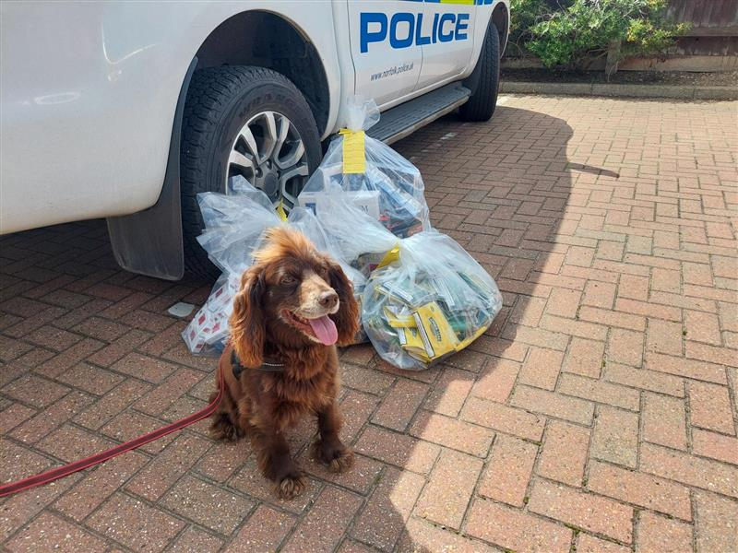
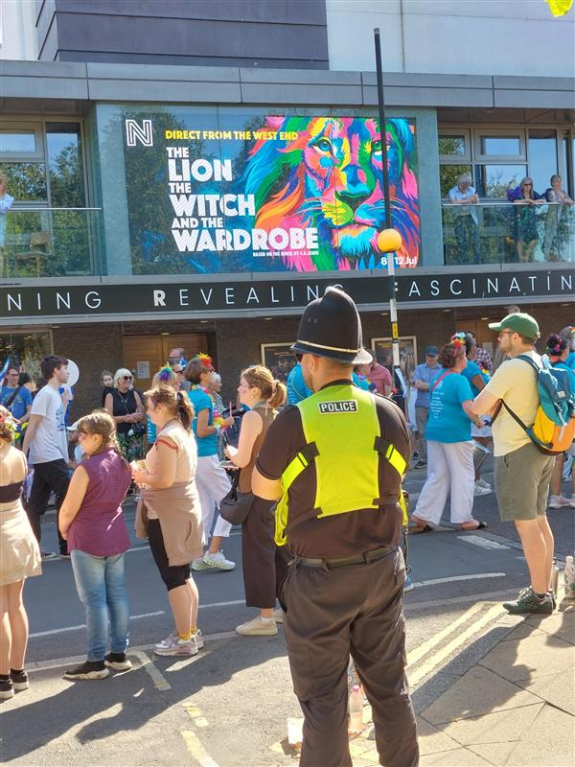
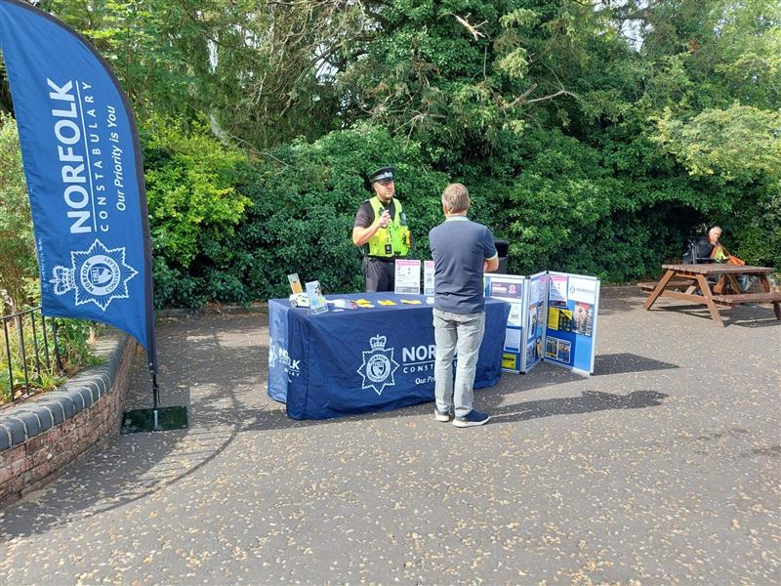

Slide 16
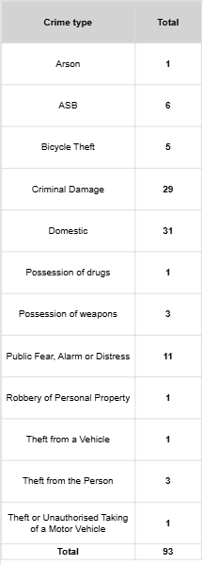
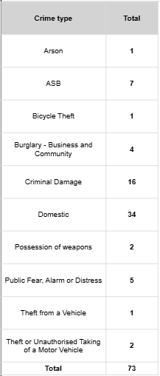
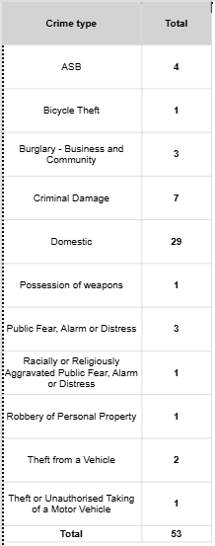
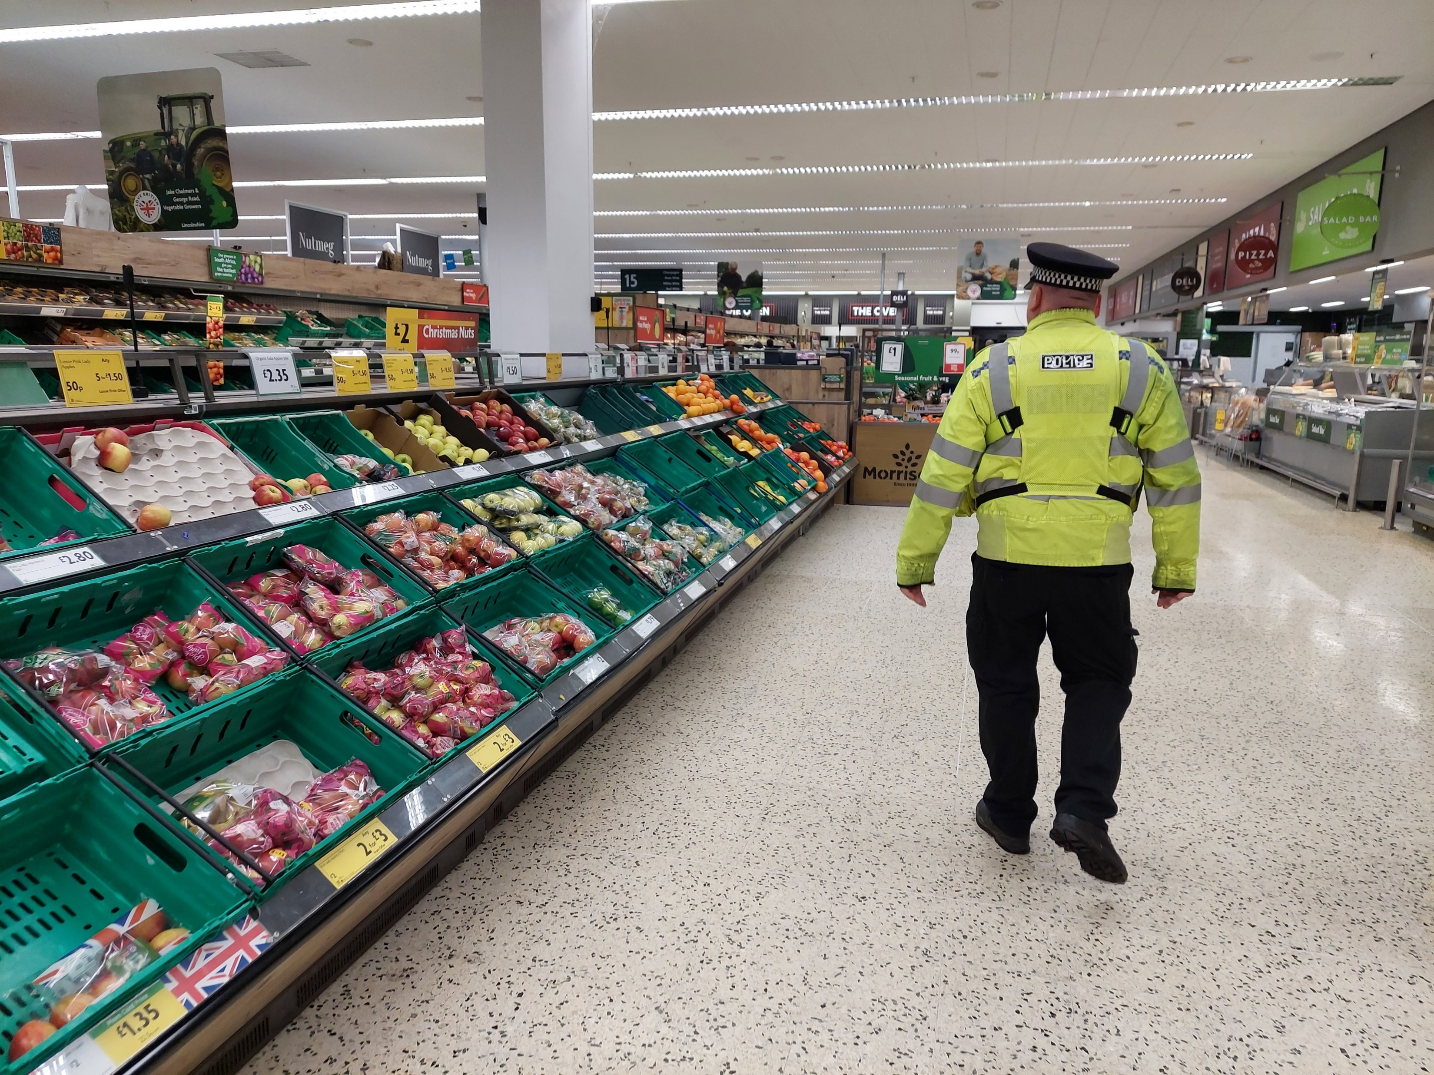
Diss, Long Stratton and Harleston crime Trends
Diss Crimes
July – Sept 2025
Long Stratton Crimes
July – Sept 2025
Harleston Crimes
July – Sept 2025

Slide 17
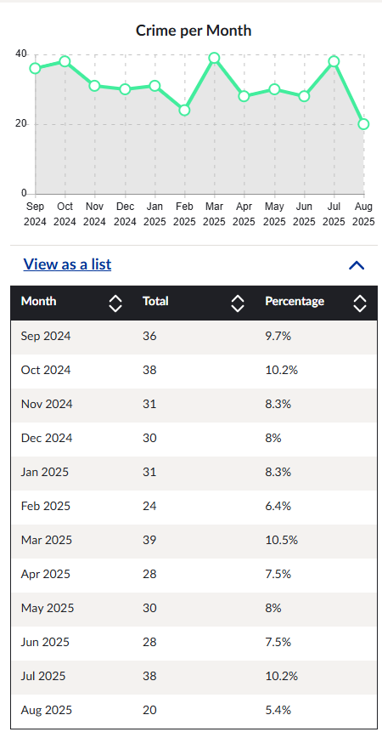
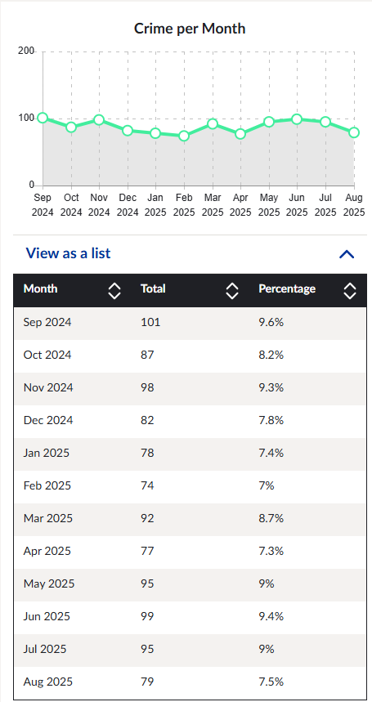
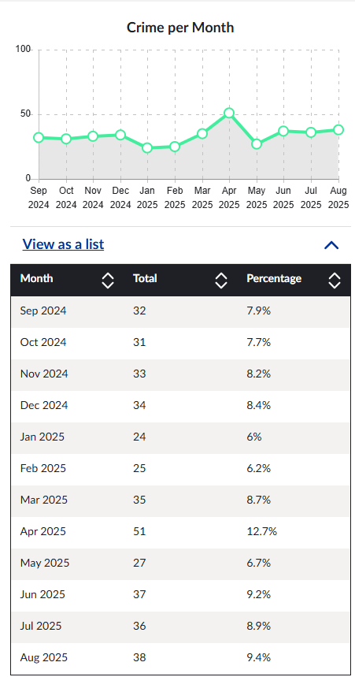
Crime Trends over the last 12 Months
Harleston
Diss
Long Stratton

Slide 18
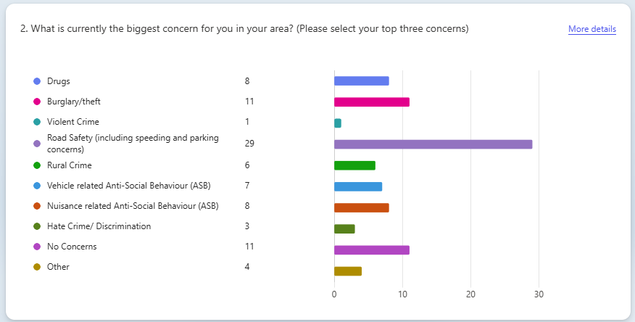
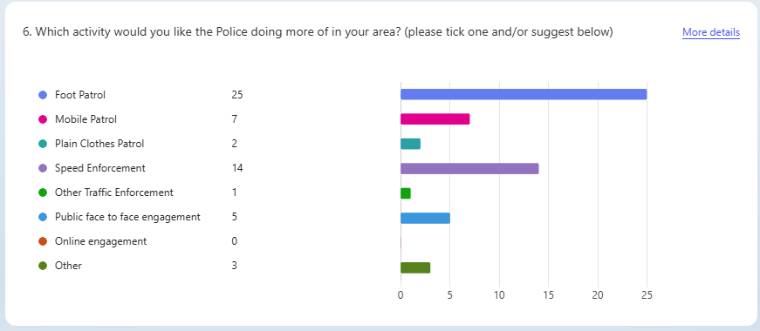
District COMMUNITY CONCERNS

Slide 19
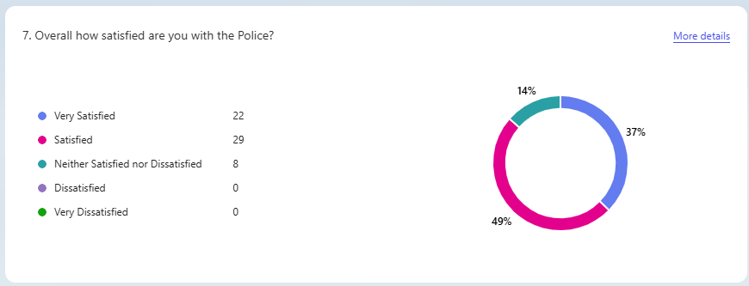
District Public Satisfaction
Notes:
What the public think about us is really important, the above is based off a fairly small group of people we have spoken too in the past three months and may not reflect the true feeling, we are always grateful for feedback both positive and negative, we can only deal with your concerns if you tell us about. We are reliant on our communities working with us which leads nicely onto our next two slides.

Slide 20

Neighbourhood Watch
On a local level, Neighbourhood Watch are run within communities, by local volunteer Coordinators. Schemes work in a variety of ways that reflect the needs of the local community including:
Sharing crime prevention advice and information
Running awareness campaigns
Holding social events and awards for local people and businesses
Leading community projects, such as litter picks, a community café, flood defence response, presentations in schools and work with young people and children and community messaging with the police.

Slide 21


Slide 22
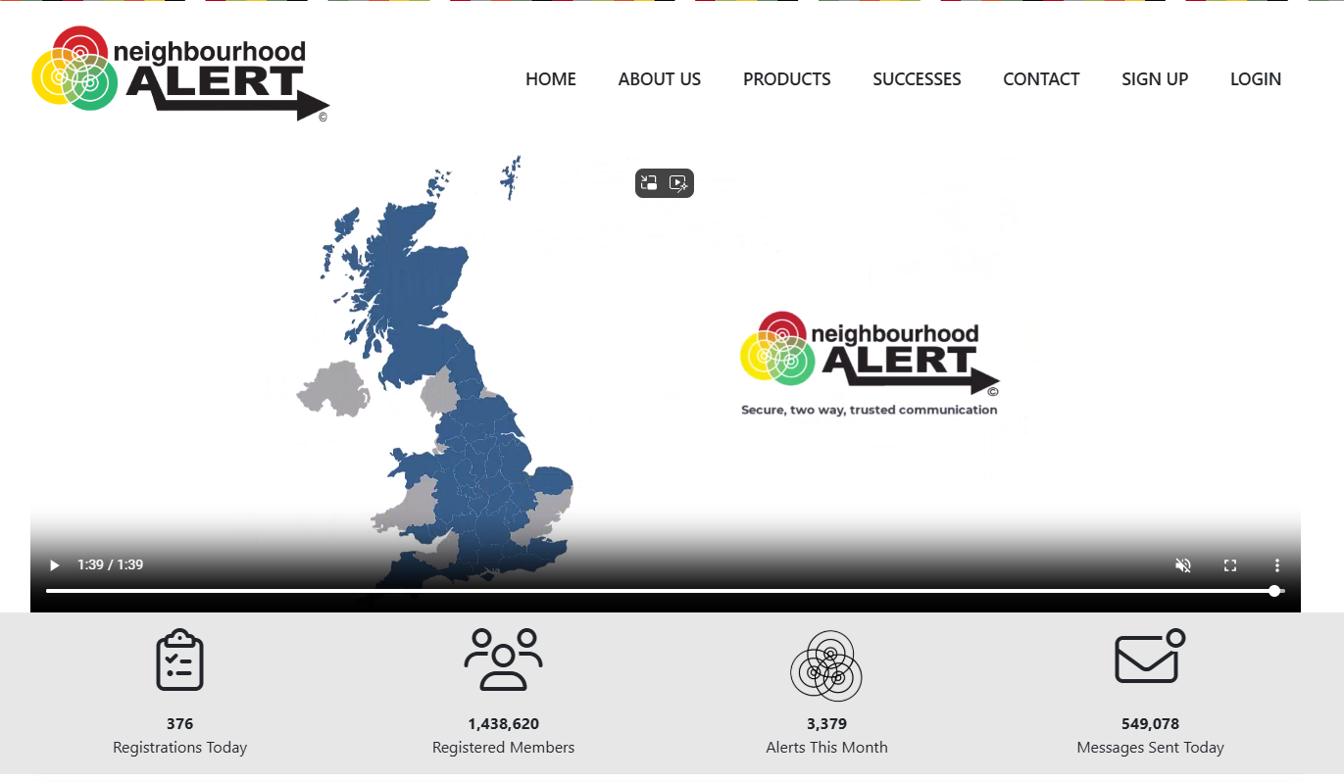
www.neighbourhoodalert.co.uk
Receive updates from
Norfolk Constabulary
Action Fraud
Get Safe online
Neighbourhood Watch

Slide 23
Useful websites
www.norfolk.police.uk
www.police.uk
www.neighbourhoodalert.co.uk

Slide 24
Dates for your diary
Street Surgeries 2025
25th October 09:00 – 10:30 – Long Stratton – Swan Lane, outside the shops.
11:00 – 12:30 – Harleston – Market Place
14:00 – 15:30 – Diss - Mere’s Mouth
21st November 09:00 – 10:30 – Woodton, Hempnall Road, by village notice boards
11:00 – 12:30 – Pulham St Mary by the Pennoyer Centre
14:00 – 15:30 – Bressingham, High Road, by Village Hall
7th December 09:00 – 10:30 – Forncett St Peter, Aslacton Road by the Church
11:00 – 12:30 – Denton, Norwich Road, by the park
14:00 – 15:30 – Tibenham Pristow Green Lane by Recreation Ground/ Hall
Library Surgeries 2025
October – Long Stratton – Monday 6th 11:00 -12:00
Diss – Thursday 16th 11:00 -12:00
Harleston - Friday 24th 12:00 – 13:00
November - Harleston – Monday 3rd 12:00 – 13:00
Long Stratton – Monday 10th 11:00 – 12:00
Diss – Thursday 20th – 10:00 – 11:00
December – Harleston – Monday 8th 12:00 to 13:00
Long Stratton – Thursday 11th 16:00 to 17:00
Diss - Thursday 18th 10:00 to 11:00
Next Quarterly Neighbourhood Policing Meeting Thursday 15th January – 18:00 -@ Long Stratton, venue to be confirmed .

Slide 25
Any questions?
Notes:
We have a feedback form if you wish to complete this after, or we will be around to have a chat with or you can email us with any feedback, comments or concerns… details on next slide.

Slide 26

Thank you
If you have any queries, please email us at:
PC 1883 HALL SNTSouthnorfolk@norfolk.police.uk
PC 1039 BAKER SNTSouthnorfolk@norfolk.police.uk
PC 160 PHILLIPS SNTSouthnorfolk@norfolk.police.uk
Notes:
We will leave

